Slide 1
React JS
(Building First react app)
Lecture-3

Slide 2
Today’s Agenda
Improving The Previous Code
Creating Function Based React Element
Creating Siblings
Creating Nested Components

Slide 3
Improving Our Previous Code
Although our previous code worked fine , but it would be better if we can consolidate the process of creating and returning a React element.
So, it would be better if we design a function which creates and returns our Heading element

Slide 4
Improving Our Previous Code
To implement this we need to do the following:
Define a function which creates and returns our heading element.
Change the code in the calling script

Slide 5
Step 1 : Defining The Function
As first step we will define a function called MyApp() which will contain the code to create and return our heading element.
Notice that in React it is a general recommendation to start function names returning react element/component with an upper case character

Slide 6
Step 1 : Defining The Function
<script>
function MyApp() {
let myElement = React.createElement("h1", null, "React Rocks!!");
return myElement;
}
</script>

Slide 7
Step 2 : Changing Code In render()
As second step we will make a small change in the calling script
The change is to pass just one argument to the createElement() method and that will be the name of our newly created function i.e. MyApp

Slide 8
Step 2 : Changing Code In render()
<script>
let element = React.createElement(MyApp);
let mydiv = document.querySelector("#root");
ReactDOM.render(element, mydiv);
</script>

Slide 9
Shorter Code
<script>
document.querySelector("#root");
ReactDOM.render(
React.createElement(MyApp),
mydiv);
</script>

Slide 10
The Final Code
<!DOCTYPE html>
<html lang="en">
<head>
<title>Using React With CDN</title>
<script crossorigin src="https://unpkg.com/react@18/umd/react.development.js">
</script>
<script crossorigin
src="https://unpkg.com/react-dom@18/umd/react-dom.development.js">
</script>
</head>
<body>
<div id="root"></div>
<script>
function MyApp() {
let myElement = React.createElement("h1", null, "React Rocks!!");
return myElement;
}
let mydiv=document.querySelector("#root");
ReactDOM.render(
React.createElement(MyApp),
mydiv
);
</script>
</body>
</html>

Slide 11
An Important Point !
In the previous code you might think that instead of passing MyApp function name to createElement() as argument , why didn’t we call it directly as shown below:
let element =MyApp();
let mydiv = document.querySelector("#root");
ReactDOM.render(element, mydiv);

Slide 12
An Important Point !
Although we could have done that for this simple example but in that case React will not treat it to be a React Component .
Hence it will not execute its Iifecycle methods or any hooks associated with it.
So if a React function is returning a React Element then we should never call it directly , rather it should be called through React.createElement()

Slide 13
Creating Siblings
Till now we have created and returned only one element , but in real world app we need to create and return multiple elements from our function.
For example , along with heading we might also need to return a para containing some text

Slide 14
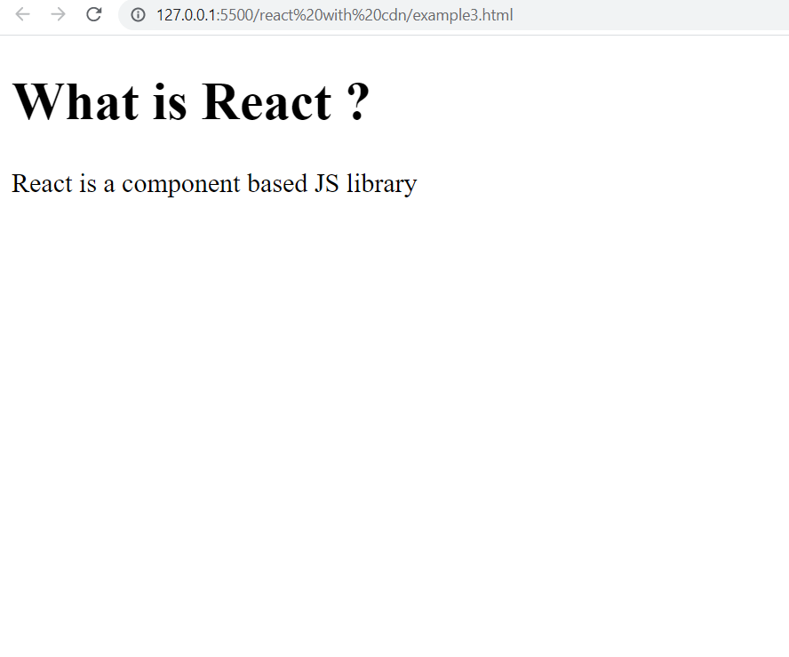
Our Next App

Slide 15
Creating Siblings
Before understanding , how to achieve this , we have to understand a very important rule in React .
The rule is that our function can return just one React element and if multiple elements have to be returned then they must be tied up to a parent element

Slide 16
Creating Siblings
This means that we cannot return heading and para as individual elements.
Rather we can add them to a parent element like <div> or something else and then return that parent element

Slide 17
Creating Siblings
So the steps will be as follows:
Create a <h1> element with the desired text
Create a <p> with the desired text.
Now create a <div> element and pass the <h1> and <p> elements as children to the <div> element
These child elements can be passed as comma separated values or as an array
Finally return the <div> element

Slide 18
The Code
<script>
function MyApp() {
let myHeading = React.createElement("h1", null, “What is React ?");
let myPara = React.createElement(
"p",
null,
"React is a component based JS library"
);
let myElement = React.createElement(
“div",
null,
myHeading , myPara
);
return myElement;
}
let mydiv=document.querySelector("#root");
ReactDOM.render(
React.createElement(MyApp),
mydiv
);
</script>
We also can pass them as an array as follows:
[myHeading,myPara]

Slide 19
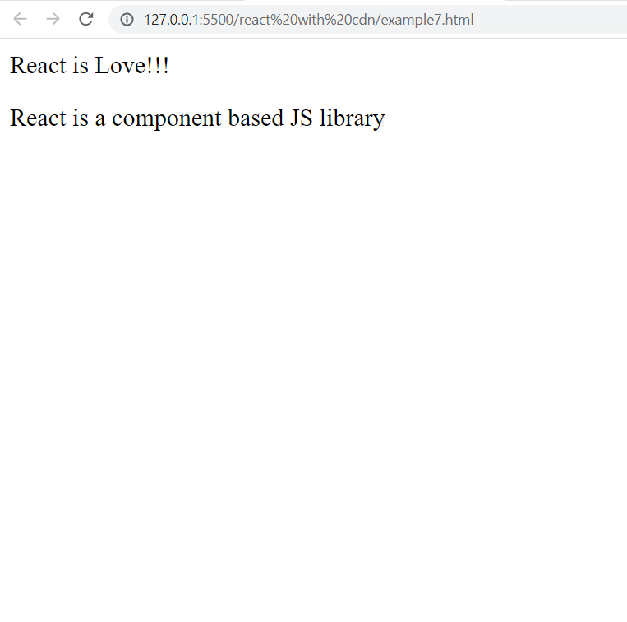
Exercise

Slide 20
The S0lution
<script>
function MyApp() {
let myElement = React.createElement(
"div",
null,
"React is Love!!!",
React.createElement(
"p",
null,
"React is a component based JS library"
)
);
return myElement;
}
let mydiv=document.querySelector("#root");
ReactDOM.render(
React.createElement(MyApp),
mydiv
);
</script>

Slide 21
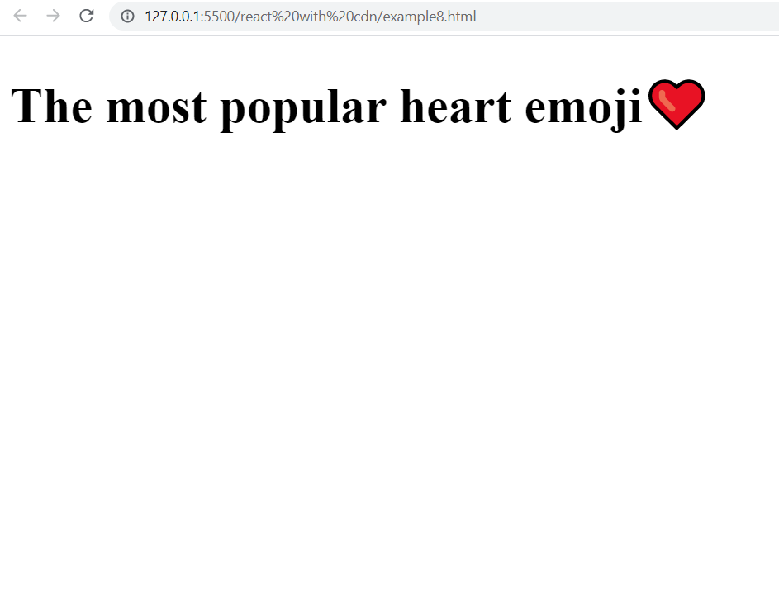
Exercise

Slide 22
The S0lution
<script>
function MyApp() {
let myElement = React.createElement(
“h1",
null,
“The most popular heart emoji",
React.createElement(
“span",
null,
"❤️"
)
);
return myElement;
}
let mydiv=document.querySelector("#root");
ReactDOM.render(
React.createElement(MyApp),
mydiv
);
</script>

Slide 23
Creating Nested Elements
We can nest children as much as we want.
This is because , in a real app, we're going to have more than just one element.

Slide 24
Creating Nested Elements
We're going to have a big nested tree of elements inside of other elements, just like we do in normal HTML.
Suppose we want to create a Contact List as shown in the next slide

Slide 25
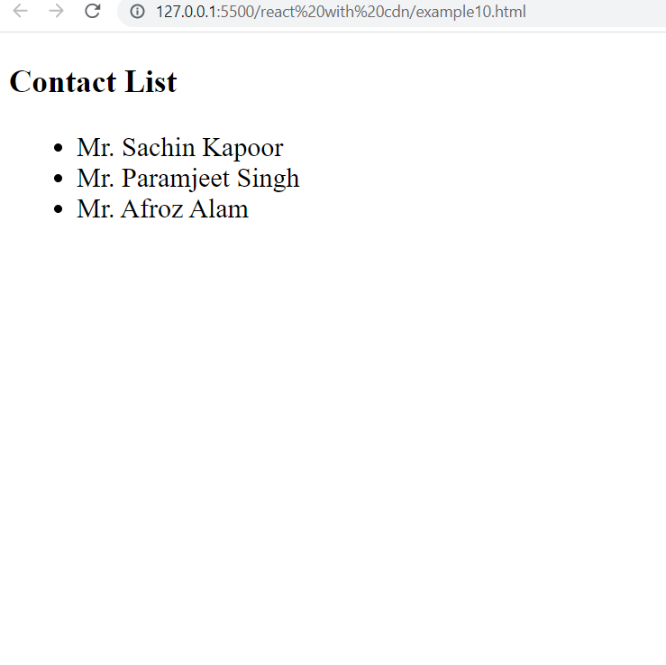
Our Next App

Slide 26
Creating Nested Elements
So the solution will be as follows:
Create a <h1> element with the desired text
Create a <ul> element.
Now create three <li> elements with the desired text and pass them as comma separated values to <ul> element.
Now create a <div> element and pass the <h1> and <ul> elements as children to the <div> element
Finally return the <div> element

Slide 27
The Code
<script>
function Contact() {
let myHeading = React.createElement("h3", null, "Contact List");
let myList = React.createElement("ul", null,
[
React.createElement("li", null, "Mr. Sachin Kapoor"),
React.createElement("li", null, "Mr. Paramjeet Singh"),
React.createElement("li", null, "Mr. Afroz Alam"),
]
);
let myComponent = React.createElement(
"div",
null,
[myHeading, myList]
);
return myComponent;
}
let mydiv=document.querySelector("#root");
ReactDOM.render(
React.createElement(Contact),
mydiv
);
</script>

Slide 28
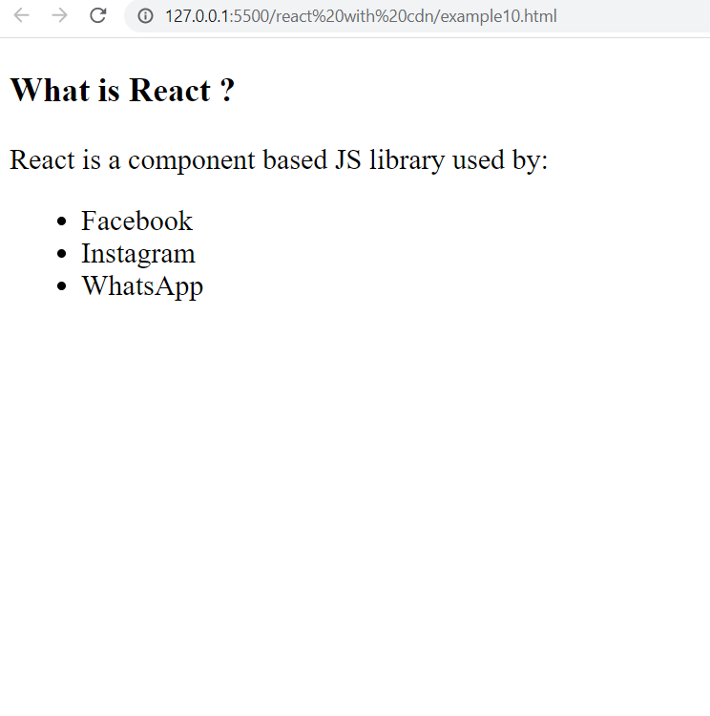
Exercise

Slide 29
The S0lution
<script>
function MyApp() {
let myComponent = React.createElement(
"div",
null,
React.createElement(
"h3",
null,
"What is React ?"),
React.createElement(
"p",
null,
[
"React is a component based JS library used by:",
React.createElement("ul", null,
[
React.createElement("li", null, "Facebook"),
React.createElement("li", null, "Instagram"),
React.createElement("li", null, "WhatsApp"),
]),
])
);
return myComponent;
}

Slide 30
The S0lution
let mydiv=document.querySelector("#root");
ReactDOM.render(
React.createElement(MyApp),
mydiv
);
</script>

Slide 31
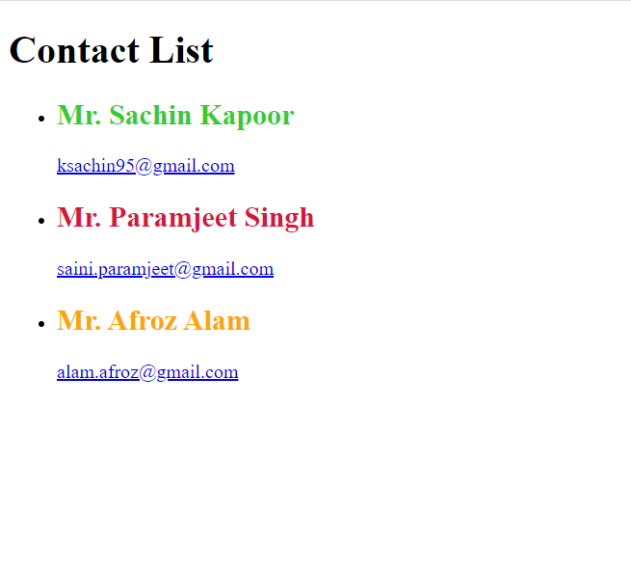
Exercise

